Slide 1
Speculative Decoding

Slide 2
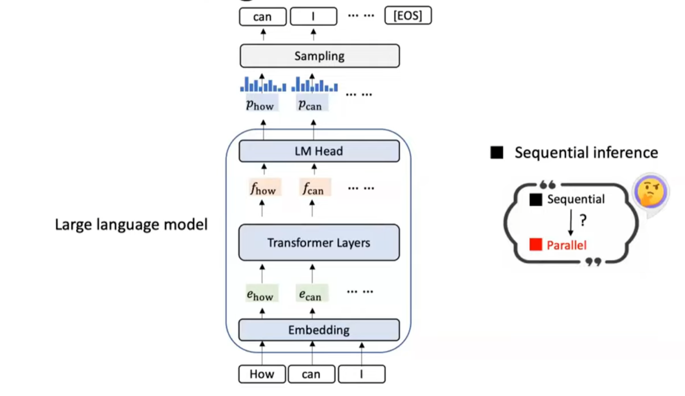
Auto Regressive Inference
Decoding phase is memory bound.

Slide 3
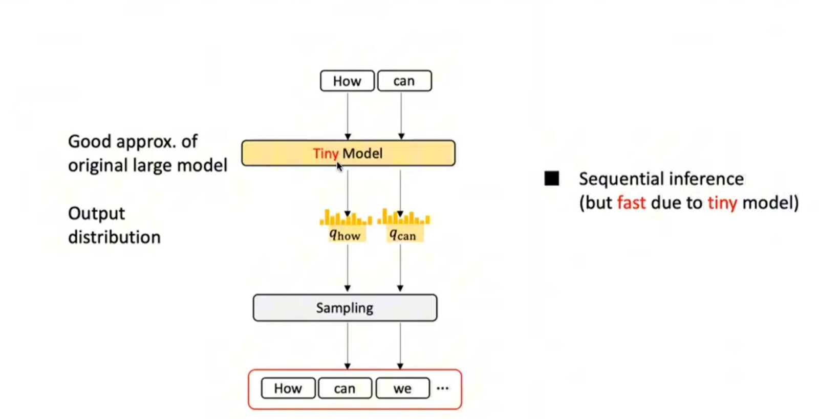
Speculative sampling framework (draft)
使用一个小巧且成本低廉的草稿模型，首先生成一个包含 K 个 token 的候选序列——一个“草稿”。然后，我们将所有这些 token 批量输入到大模型中

Slide 4
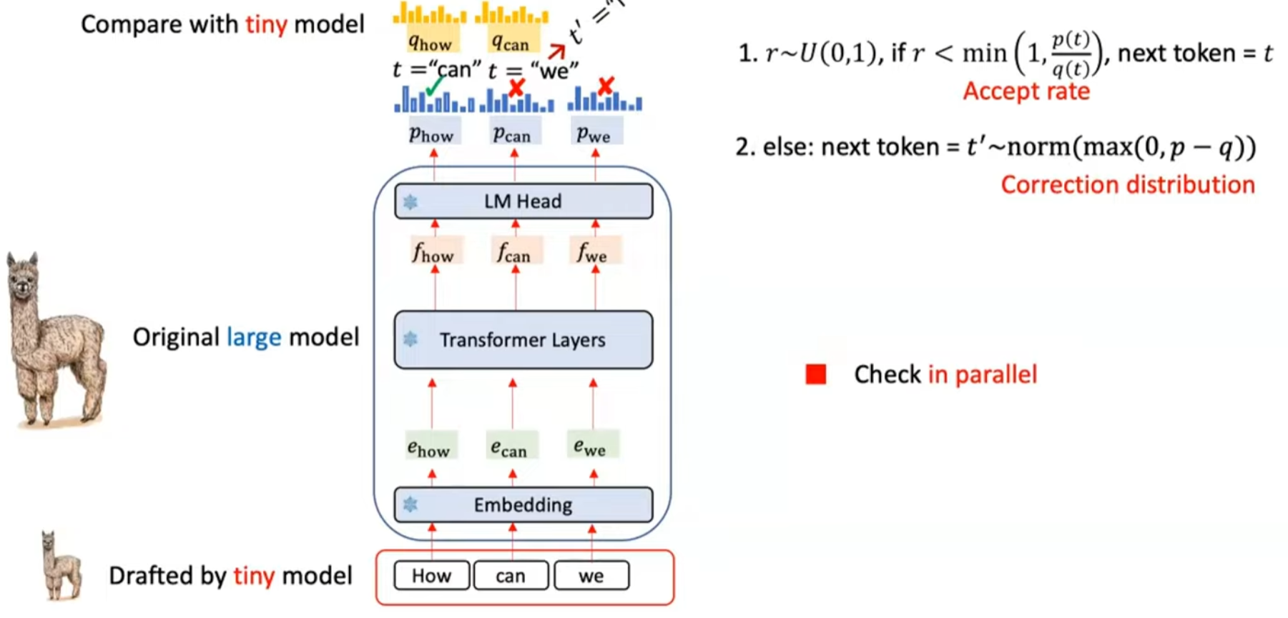
Speculative sampling framework (check)
计算访存比显著提升

Slide 5
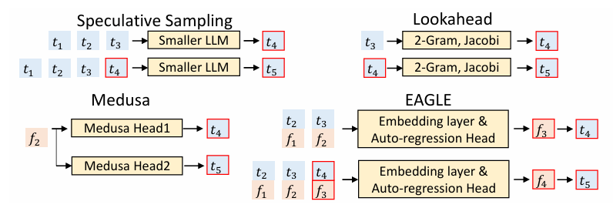
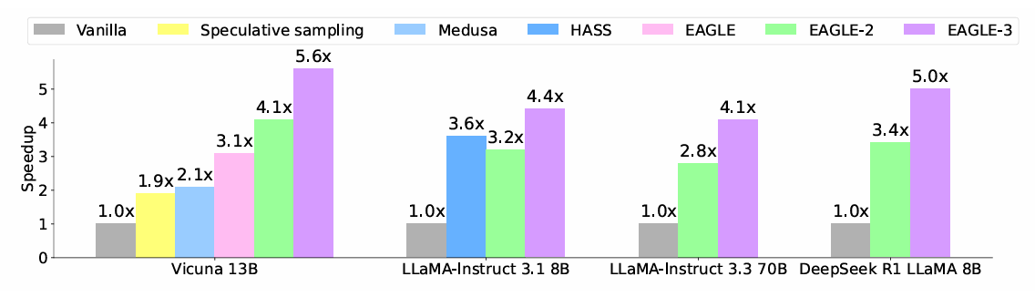
Eagle from next token prediction to next feature prediction

Slide 6
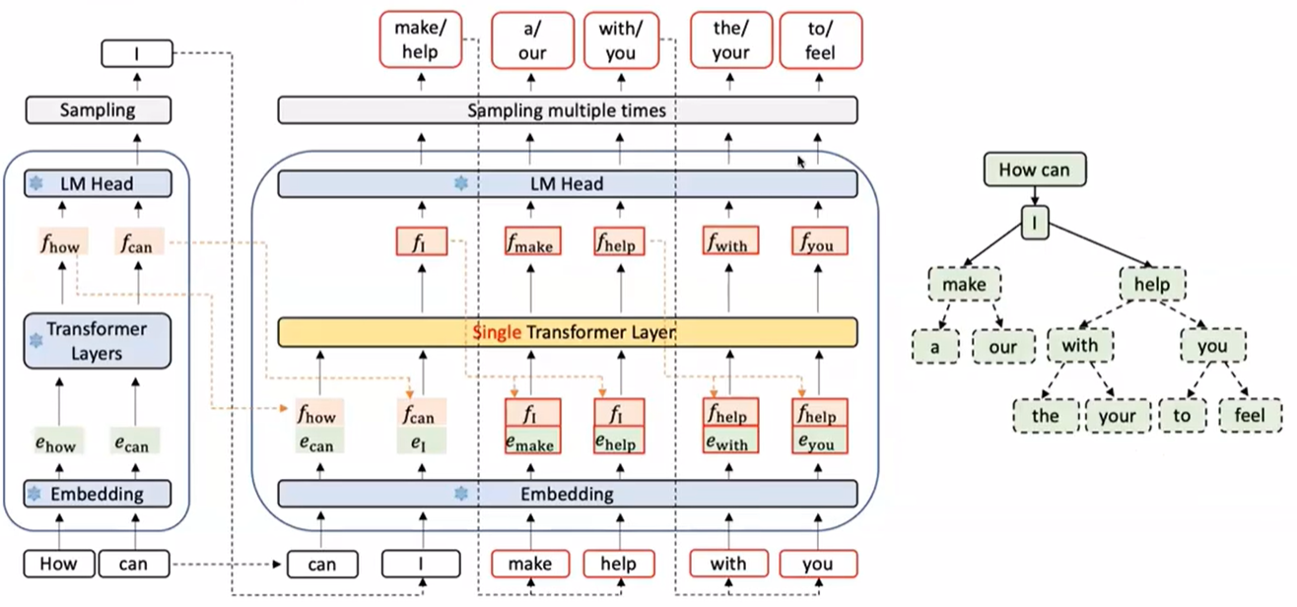
Eagle

Slide 7
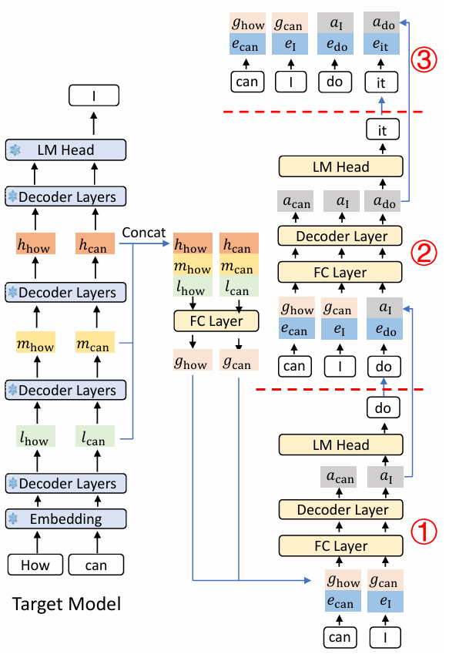
Eagle3

Slide 8
Spec decode in vllm
Spec Decode - vLLM
config.json · yuhuili/EAGLE3-LLaMA3.1-Instruct-8B at main

